Slide 1
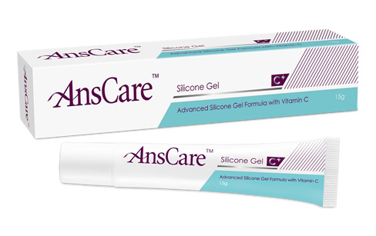
‘AnsCare’
Advanced Silicone Gel Formula with Vitamin C
BENQ

Slide 2
CONTENTS
INTRODUCTION
HOW TO APPLY SILICONE GEL
MECHANISM OF SILICONE GEL
CLINICAL OBSERVATION OF SILICONE GEL

Slide 3
INTRODUCTION

Slide 4
INTRODUCTION
No. 1 International brand to reduce hypertrophic scars, keloids, bump scars caused by external injuries or burns
100% Medical Grade Silicone Gel with Vitamin C
Vitamin C combination with Silicone Gel reduces scar discoloration
It is self-drying, transparent silicone gel which can be simply spread on any scarred parts

Slide 5
It reduces itching & discomfort associated with scars
Silicone Gel rubs against the skin to produce an electrostatic field. A stable surface electrostatic field allows collagen to be rearranged and to eliminate the specific cells that induce scar formation
‘AnsCare’ Silicone Gel with Vitamin C increases water retention of skin & regulates collagen stacking
CE/TFDA/CFDA certified

Slide 6
 | Polysiloxane, Silicon dioxide Polysiloxane, Silicon dioxide,Vitamin-C 2500 - 3100 Reduce hypertrophic scars, keloids, bump scars caused by external injuries or burns. Reduce scar discoloration
COMPOSITION
VISCOSITY (CPS)
APPLICATION

Slide 7
HOW TO APPLY SILICONE GEL

Slide 8
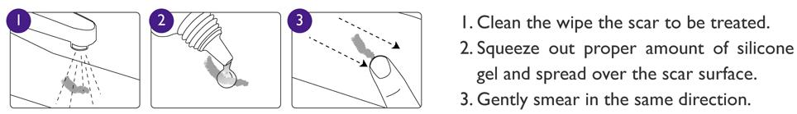
HOW TO APPLY SILICONE GEL

Slide 9
MECHANISM OF SILICONE GEL

Slide 10
MECHANISM OF SILICONE GEL TO REDUCE SCAR
Prevent water evaporation from skin
Electrostatic field between silicone & skin
Promotes increase of bFGF (Collagen turnover regulator)

Slide 11
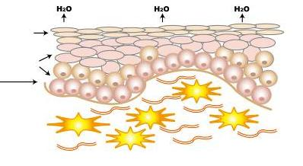
PREVENT WATER EVAPORATION FROM SKIN
Introduction of Hydration :
Epidermis
A. In normal physiology condition, the hydration of skin tissue increases the water retention, protects the skin, and maintains the normal arrangement of collagen
Keratinocytes
Dermis
Fibroblast
Collagen

Slide 12
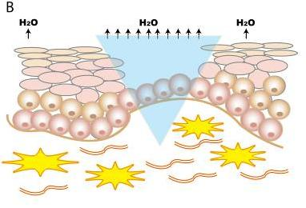
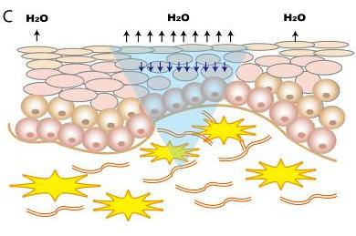
B. For wounded skin, water vaporizes in a great quantity
C. After 1~2 weeks , the skin becomes recover, but the water keeps vaporizing due to the immature keratin growth

Slide 13
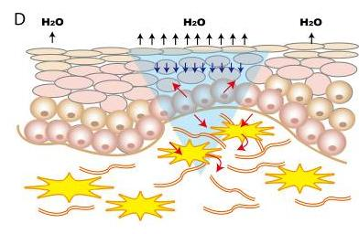
Keratinocytes
Fibroblast
Collagen
D. Water vaporization stimulates keratinocytes, and promotes the formation of fibroblasts and collagen
-> Promote Scar formation

Slide 14
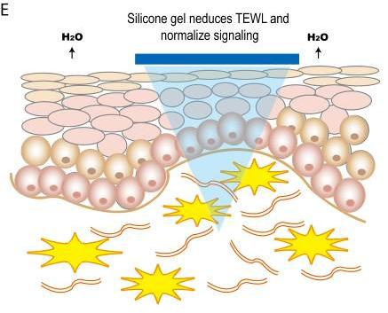
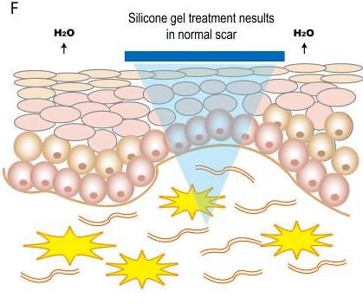
E. The silicone gel can decrease the water vaporization from epidermis, and stop continuous stimulus
F. The collagen arranged in order and prevent from scar formation

Slide 15
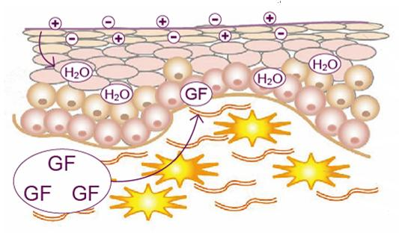
ELECTROSTATIC FIELD BETWEEN SILICONE & SKIN
It forms electrostatic field between silicone gel and skin due to friction. The electric field of epidermis is stable. It makes the rearrangement of collagen and clears the special cells that promotes scar formation

Slide 16
PROMOTES INCREASE OF bFGF
(COLLAGEN TURNOVER REGULATOR)
Increase of bFGF regulates the collagen turnover, which makes the skin to be more elastic. It inhibits abnormal extension of fibroblast, and repairs the growth of collagen tissue to linear arrangement

Slide 17
CLINICAL OBSERVATION
OF SILICONE GEL

Slide 18
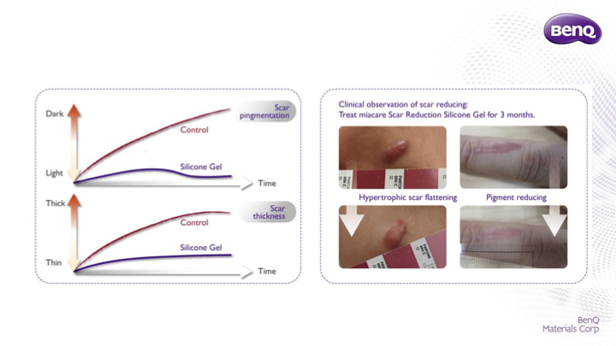
CLINICAL OBSERVATION OF SILICONE GEL

Slide 19
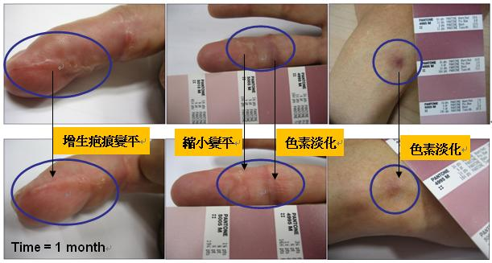
Case 1:
41-year-old male, scar on finger Continuous use for 1month

Slide 20
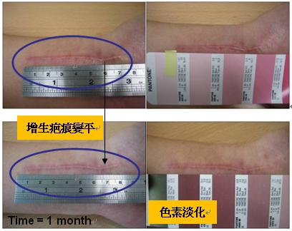
Case 2: Scar on hand Continuous use for 1month

Slide 21
THANK YOU

