Slide 1
‘MIACARE’
Acne Patch
BENQ

Slide 2
CONTENTs
INTRODUCTION
ACTION PRINCIPLE OF MIACARE ACNE PATCH
USE OF ACNE PATCH
HOW IT WORKS?
MIACARE ACNE PATCH USING DIRECTIONS
FEATURES & ADVANTAGES
COMPETIVENESS
SPECIAL DESIGN
CLINICAL PROOF

Slide 3
INTRODUCTION

Slide 4
INTRODUCTION
Top International brand for Acne cure, besides it makes the acne invisible
Medical grade Hydrocolloid patch, which helps Acne to heal faster and absorb oily secretion, fluid and pus
More absorption capability and it can quickly heal Acne without leaving the scar by creating comfortable healing environment for the Acne
MIACARE ACNE PATCH

Slide 5
Thin edge and thick central makes the Acne invisible
Not only suitable for Acnes, also for Spot wounds caused by laser operations
More absorption capability and it can quickly heal wound without leaving the scar by creating comfortable healing environment for the wound
CE marked, GMP & ISO 13485 certified

Slide 6
ACTION PRINCIPLE OF MIACARE ACNE PATCH

Slide 7
ACTION PRINCIPLE OF MIACARE ACNE PATCH
Material: hydrocolloid, which helps wound to heal faster
The hydrocolloid: absorb oily secretion, fluid and pus
The patch acts as a protective layer that prevent the acne wound from infection
Miacare Acne Patch provides an ideal environment for acne healing

Slide 8
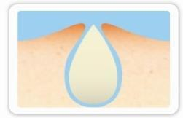
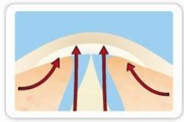
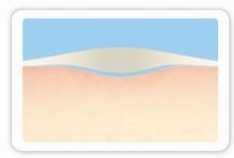
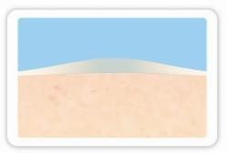
1. Acne with pus
2. Attach acne patch which absorbs the pus
3. After pus absorption, acne patch acts as protective layer that prevent from bacteria infection
4. The acne wound is recovered & leave without scar

Slide 9
USE OF ACNE PATCH

Slide 10
USE OF ACNE PATCH
The use of acne patch (Hydrocolloid dressing):
1. Acne
2. The minor plastic surgery wound

Slide 11
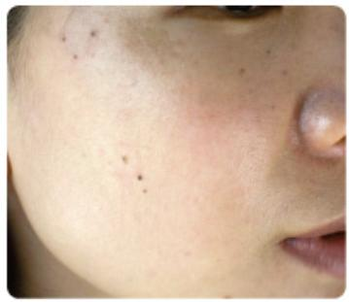
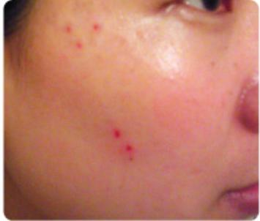
1. Before laser treatment
2. Five wounds after laser treatment

Slide 12
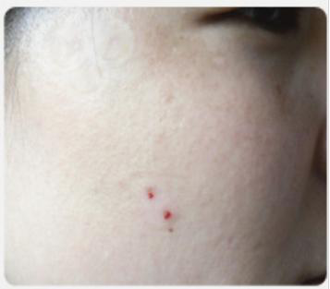
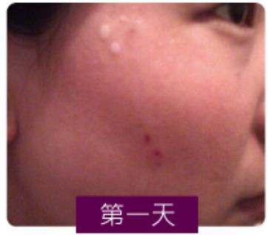
(1st Day)
4. The dressing absorbs excessive fluid. Change the dressing, when it turns into white color
3. Three wounds in upper side is covered with Anscare Hydrocolloid dressing. The two wounds in lower side has no dressing covering, which regards as control

Slide 13
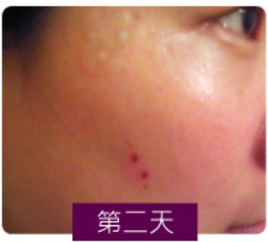
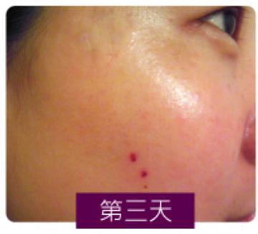
(2nd Day)
(3rd Day)
6. No fluid secretion. The dressing can be changed after covering 3-5 days
5. Less fluid secretion. Hydrocolloid dressing creates moist healing environment, promote wound
healing without scab

Slide 14
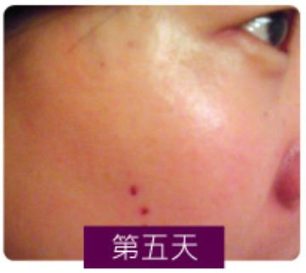
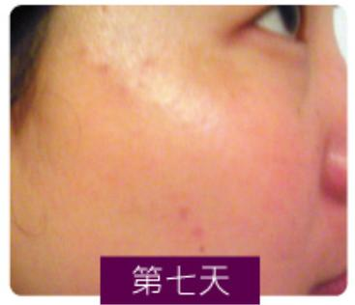
(5th Day)
(7th Day)
8. The wound is completely closed, and pigment is obviously less than control
7. Keep using AnsCare Hydrocolloid dressing. It not only protects wound and promotes healing, but also make the wound become invisible

Slide 15
HOW IT WORKS?

Slide 16
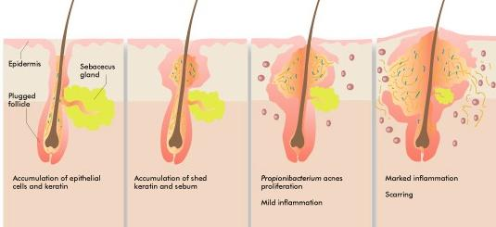
HOW IT WORKS?

Slide 17
Step 1
Oil Secretion
Step 2
Follicle Blocked
Step 3
Bacteria Proliferation
Step 4
Inflammation
Step 5
Acne Scar

Slide 18
MIACARE ACNE PATCH USING DIRECTIONS

Slide 19
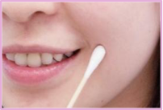
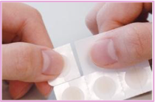
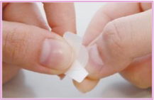
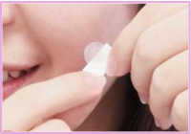
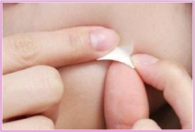
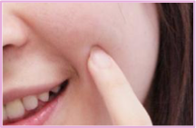
MIACARE ACNE PATCH USING DIRECTIONS
Step 1: Clean the acne area and hands. Dry them well
Step 2: Tear off one of the acne patch
Step 3: Remove half of the release paper
Step 6: Gently press the patch for 3-5 seconds for better adhesion & invisibility
Step 4: Attach the center of acne patch to acne
Step 5: Remove the other half of release paper

Slide 20
FEATURES & ADVANTAGES

Slide 21
FEATURES
Thin exterior and thick interior design
Ultra-thin
Easy tearing design
High stickiness
High absorption
Absorb over 95%UVB

Slide 22
ADVANTAGES
Highly invisible
Perfect fit, without foreign body sensation and easy for makeup
Convenient to use and no need accessory
Close to skin and not easily to fall off
Absorb more pus, maintains cleanliness and hygiene
Reduce melanin precipitation

Slide 23
COMPETIVENESS

Slide 24
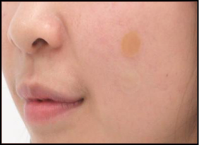
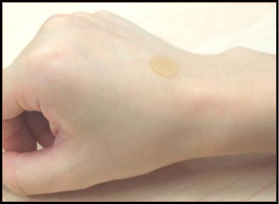
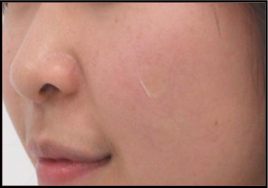
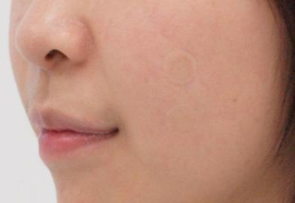
COMPETIVENESS
Miacare
3M Nexcare
3M Nexcare
Miacare
Miacare: High Invisibility
Miacare: High Invisibility
Other Brand: C-Dow
Other Brand: Darcy
Miacare
Miacare
Miacare: High Invisibility
Miacare: Light Reflection

Slide 25




Best Performance
 | Miacare | C-Dow | Wegis | 3M
Sample Thickness(mm) | 0. 4764 | 0. 4134 | 0. 247 | 0. 4608
Edge(mm) | 0.0734 | * 0.0716 878.85 | X | X
Stickiness Test | * 1234.78 |  | 724.38 | 230.05
Absorption Test(8hrs) | 493% | * 616% | 34% | 234%
Absorption Test(24hrs) | * 670% | 600% | 66% | 232%
UVB exposure amount | 1.4 | 3.5 | * 0. 65 | 1.2
pH | 6 | 6 | 6 | 6
Eccentricity(Max:mm) | 3 | 2.9 | X | X
Absorption surface(mm) | 8 | 8 | 12 | 12
Total surface(mm) | 12 | 12 | 12 | 12
Color (by color card) | Center- 7403C, Edge-transparent | Center- 80% lighter than7401C,Edge- transparent | 7402C | 7402U
Offset of tearing line (mm) | 9.5/9 | N/A | N/A | N/A

Slide 26
SPECIAL DESIGN

Slide 27
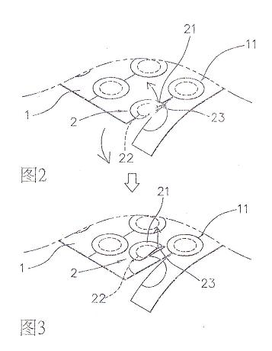
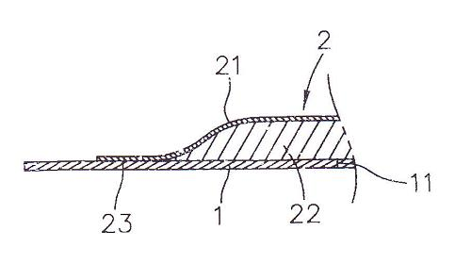
Special design of miacare acne patch
Thin exterior & thin interior design
Easy tearing Design

Slide 28
CLINICAL PROOF

Slide 29
CLINICAL PROOF OF MIACARE ACNE PATCH
A clinical observation of hydrocolloid dressing in treatment of acne vulgaris:
Bi Zhi-gang, Lu Gui-qing, Kang Li, Liu Yan, Fu Zhi-liang, Chu Xiao-yan, Yin Xiao-qing, Wang Yi-ting (Department of Dermatology, BenQ Medical Center, Nanjing Medical University, Nanjing, 210019) Corresponding author: Bi Zhi-gang, E-mail:Elton.bi@benqhospital.com
Objectives: To evaluate the safety and the clinical efficacy of hydrocolloid dressings in treatment of mild and moderate acne vulgaris.

Slide 30
Methods:
120 cases of mild and moderate acne vulgaris were randomly divided into treatment group and control group (each group with 60 cases). miacare acne patch, which made from hydrocolloid dressing, was applied in the treatment group and 0.025% tretinoin creams were applied in the control group, 1 time/ day, a total of 4 weeks. Before and after treatment with 3, 7, 10, 14, 17, 21, 24, 28 days, the lesions of the acne were observed respectively and the curative effect and adverse reaction were recorded and analyzed.
Results:
During the course of treatment and after 4 weeks of therapy, miacare acne patch was more effective than 0.025% tretinoin creams on pustule. At the day 7, 10, 14, 17 of treatment, the clinical curative effects of miacare acne patch were obviously higher than those of 0.025% tretinoin cream with statistically significant difference (P<0.05). No obvious adverse reaction was observed in the treatment group.

Slide 31
Time (days ) | Group | Evaluation (Frequency) |  |  |  |  |  |  | Comparison
 |  | Cure | Excellent | Improved | Invalid | Worse | Invalid Data | Total | Statistics | P
3d | A | 3 | 1 | 13 | 34 | 1 | 8 | 60 | 5. 757 | . 218
 | B | 1 | 2 | 9 | 39 | 6 | 3 | 60
*7d | A | 4 | 4 | 27 | 15 | 2 | 8 | 60 | 11. 427 | . 022
 | B | 4 | 3 | 14 | 34 | 2 | 3 | 60
*10d | A | 10 | 7 | 22 | 9 | 4 | 8 | 60 | 12. 110 | . 017
 | B | 6 | 7 | 13 | 27 | 4 | 3 | 60
*14d | A | 8 | 9 | 22 | 9 | 4 | 8 | 60 | 12. 895 | . 012
 | B | 8 | 7 | 10 | 25 | 7 | 3 | 60
*17d | A | 11 | 13 | 21 | 5 | 2 | 8 | 60 | 14. 559 | . 006
 | B | 8 | 5 | 20 | 22 | 2 | 3 | 60
21d | A | 14 | 8 | 22 | 7 | 1 | 8 | 60 | 7. 750 | . 101
 | B | 13 | 5 | 17 | 20 | 2 | 3 | 60
24d | A | 15 | 9 | 20 | 8 | 0 | 8 | 60 | 7. 187 | . 126
 | B | 19 | 6 | 13 | 18 | 1 | 3 | 60
28d | A | 20 | 11 | 15 | 6 | 0 | 8 | 60 | 3. 932 | . 415
 | B | 18 | 10 | 15 | 12 | 2 | 3 | 60

Slide 32
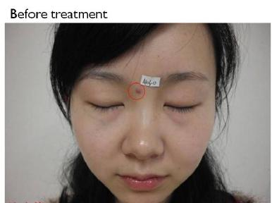
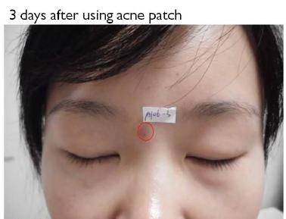
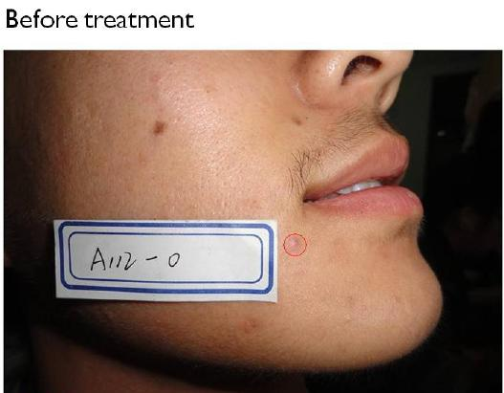
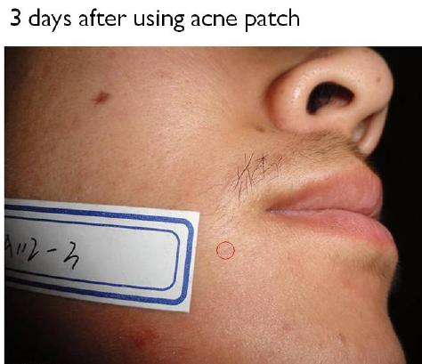

Slide 33
THANK YOU

