Slide 1
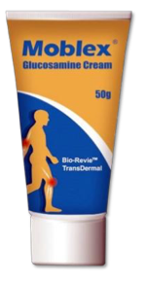

‘MOBLEX’
Glucosamine Cream
BIONIN BIOTECHNOLOGY

Slide 2
CONTENTS
INTRODUCTION
GLUCOSAMINE IN CREAM FORM
BIO-REVIETM, INNOVATIVE TRANSDERMAL TECHNOLOGY
EFFECTIVENESS & FACTS

Slide 3
INTRODUCTION

Slide 4
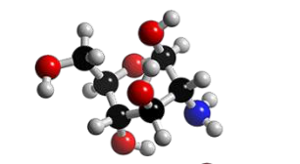
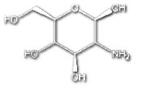
INTRODUCTION
MOBLEX provides an effective treatment for joint related conditions such as Osteoarthritis and Rheumatoid Arthritis
It stimulates the creation of the cartilage and relieves the pain due to cartilage damage for joint support

Slide 5
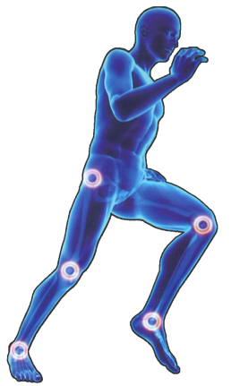
Glucosamine delivered with the innovative Transdermal technology provides an effective & direct way to the required local area
Transdermal technology with active ingredients offers an effective carrier for Glucosamine to be transferred to body tissues
Most effective option to relieve joint pain, stiffness and discomfort
Size 50 gm (for 6-8 weeks usage)

Slide 6
GLUCOSAMINE IN
CREAM FORM

Slide 7
GLUCOSAMINE IN CREAM FORM
Oral delivery in tablet or capsule is the conventional way to supplement Glucosamine indirectly to the joints
Glucosamine delivered with the innovative transdermal technology in form of cream provides an effective way to the local area where does need it

Slide 8
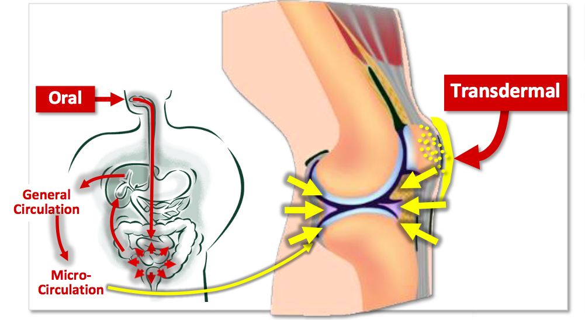

Slide 9
BIO-REVIETM, INNOVATIVE
TRANSDERMAL TECHNOLOGY

Slide 10
BIO-REVIETM, INNOVATIVE TRANSDERMAL TECHNOLOGY
Large molecules such as Glucosamine HCl cannot diffuse through lipids which cannot cross the membrane unless they are transported by a carrier mechanism
Bio-RevieTM technology with active ingredients offers an effective carrier for Glucosamine to be transferred to body tissues

Slide 11
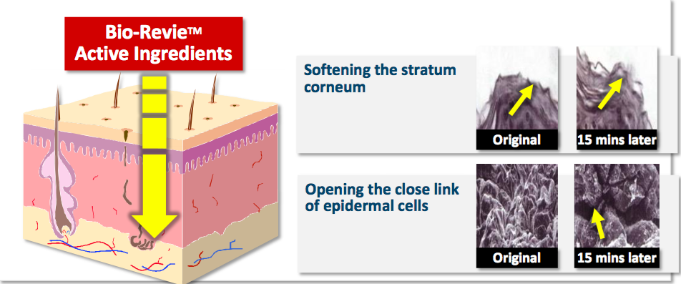

Slide 12
FORMULATOR | TAHO Pharmaceuticals Ltd.
FORMULATION | Cream, external use only
MAIN INGREDIENTS | Glucosamine HCl 10%* Peppermint oil Menthol
PACKAGE | 50g/tube (for 1-2 month supply)
APPLICATION | Twice Daily Recommended
BRIEF | Relieve joint pain, stiffness, discomfort Deep penetration Easy to use and carry No gastro enteric trouble (external use) Bio- RevieTM DDS technology

Slide 13
EFFECTIVENESS & FACTS

Slide 14
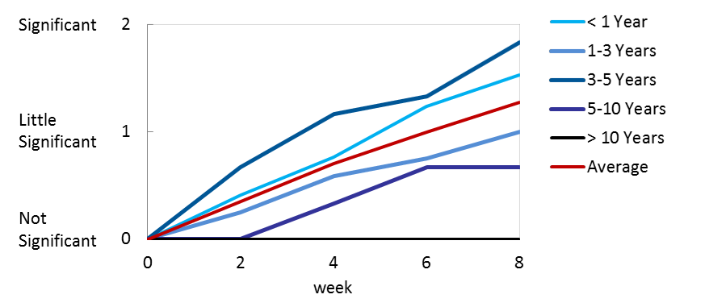
EFFECTIVENESS & FACTS
Moblex Glucosamine Cream has exact efficacy in treating osteoarthritis. It can effectively relieve symptoms like pain & stiffness caused by osteoarthritis after 4 and 8 weeks
Efficacy and Safety Study of Moblex from Patients having Knee Osteoarthritis in Different History

Slide 15
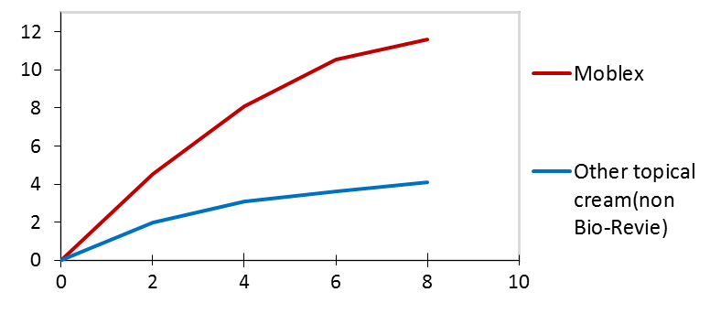
Moblex Glucosamine Cream with Bio-RevieTM has higher penetration volume than other existing cream after 4 and 8 hours
Tape Stripping Test- Comparing to Other Existing Cream

Slide 16
THANK YOU

