Slide 1
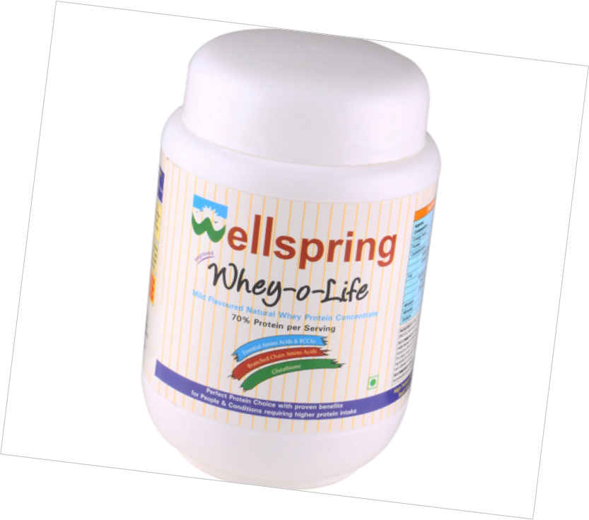
‘WHEY-O-LIFE’
Natural Whey Protein Concentrate
WELLNESS QED

Slide 2
CONTENTS
INDICATIONS
FEATURES
COMPOSITION
RECOMMENDED DOSAGE
APPLICATION

Slide 3
INDICATIONS

Slide 4
INDICATIONS
Protein of choice for critical care & high protein requirements
Helps protects against certain types of harmful bacteria and viruses
Improve body mass composition & enhances physical performances
Ideal for pregnant women
Maintains bone strength

Slide 5
Promote growth in children
Helps maintain a healthy weight
Provide protein for those on restricted diets
Maintain cardiovascular health.
Help wound healing
Support immune system, has antioxidant, anti carcinogenic actions

Slide 6
FEATURES

Slide 7
FEATURES
70% whey protein concentration of highest quality protein
Contain all the essential amino acids
Superior digestibility, bio-availability and amino-acid profile compared to other protein sources like milk, casein, egg, soy or meat.
Best possible amino acid profile
Contain glutathione (the wonder anti oxidant)

Slide 8
Easy to digest
Carefully fortified to make it extremely useful for patients undergoing chemotherapy or radiotherapy
Sugar free, gluten Free, steroid free, drug free & egg free

Slide 9
COMPOSITION

Slide 10
COMPOSITION
Approx Composition | Typical Values Per 100 (Kcal)
Enery Value | 398 Kcal
Protein | 70% on dry basis
Carbohydrates | 18.0 g
Added Sugar | Nil
Dietary Fibres | Less than 2 g
Fat | 6.0 g
Saturated Fats | 2.5 g
Trans Fats | Less Than 0.5 g
Cholesterol | Less Than 0.5 g
Moisture | 3%
Minerals | 5.0 g
Sodium | 17 mg

Slide 11
RECOMMENDED DOSAGE

Slide 12
RECOMMENDED DOSAGE
10 to 30 g daily or recommended by your health professional

Slide 13
APPLICATION

Slide 14
APPLICATION
Can be mixed with milk, curd, porridge, soup, custard, pudding & juice
SPECIFICATION
70% Whey protein concentrate
Contain glutathione
500 gm box

Slide 15
THANK YOU

